Slide 1
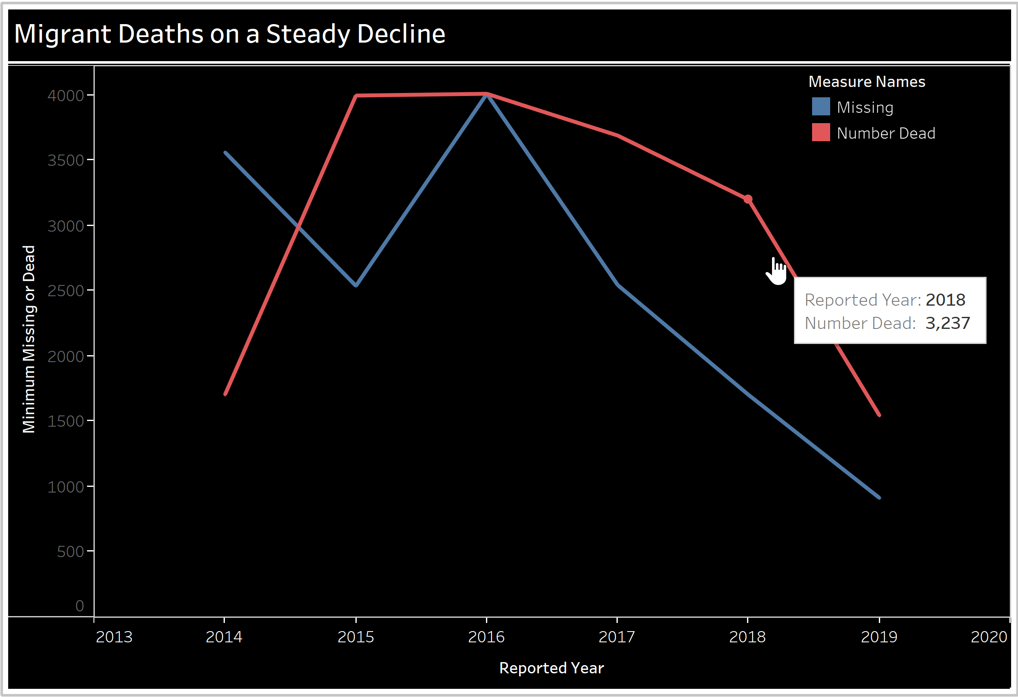
Migrant Deaths on the Decline - But is that really a good thing?
Migrant Deaths have currently dropped from the record highs experienced in the last few years.
In 2016, Turkey was offered a deal worth billions in aid for blocking off part of the migration path

Slide 2


Missing Migrant Project
A journey into the story behind the data
Shreya Prabhu & David Lee

Slide 3

Motivation
An attempt to understand the number of refugees and asylum-seekers affected by the International Crisis currently progressing around the world – and how the trends are changing.

Slide 4
Agenda
Missing Migrant Project (IOM)
Overview of International Crisis
Major Causes of Deaths and Missing People
Demographics Affected
Timeline of Migration
Region Specific Causes
How this Analysis can Help

Slide 5












Who are the Missing Migrants?
These migrants come from all over the world, traveling to escape poverty, war, and even genocide
While these migrants are on the road & abroad, IOM does their best to provide advice to services to these migrants and related governments

Slide 6
Major International Crises
Middle-East & Mediterranean
Syrian Conflict
Africa
Insurgency: Egypt, Somalia, Boko Haram
Civil War: South Sudan, Libya
Kenya Election Conflicts
Asia
Myanmar Conflict
Insurgency in Thailand
Spillover of the Syrian Civil War
Central America
Gang warfare and violence
Economic Crisis

Slide 7
Data
6000 reported incidents between
2013 and 2019
Each record contains multiple people being affected
Overview:
Total Missing Migrants:
15274
Total Reported Dead:
18368
Affected Males:
6053
Affected Females:
2108
Affected Children:
1741

Slide 8
Purpose of Analysis
Track the trends in Migrants and their movement over time
Identify areas where intervention can be provided

Slide 9
Dead and Missing by Region

Slide 10
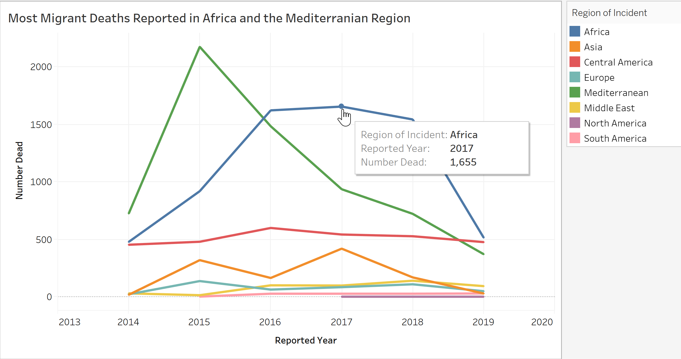

Slide 11
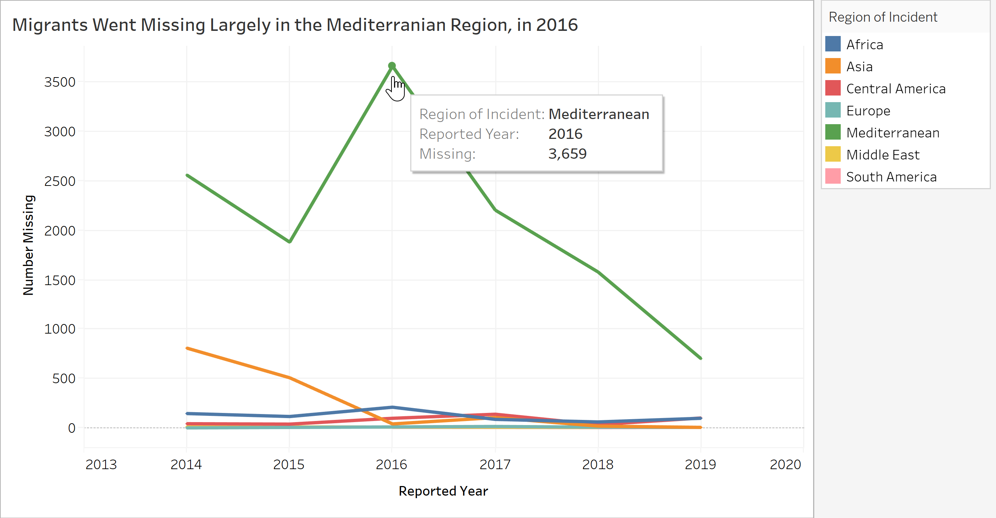

Slide 12
Major Causes for Deaths and Missing People

Slide 13
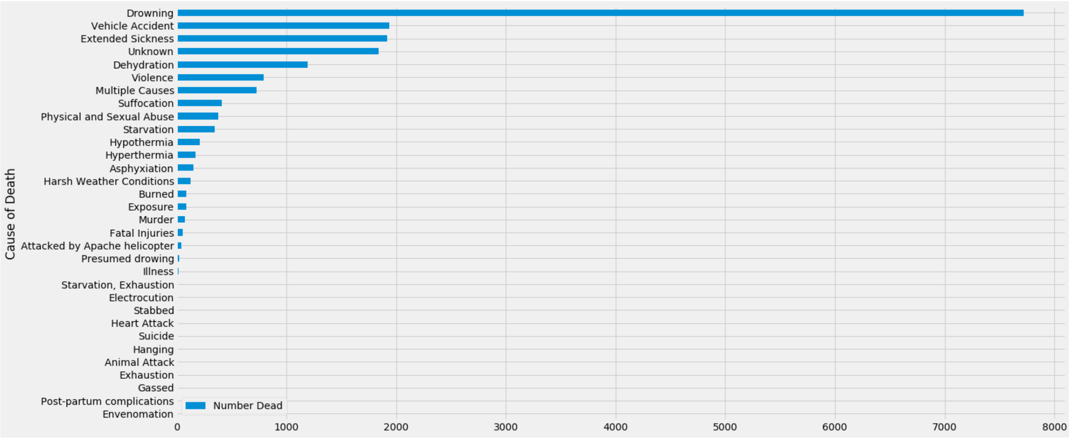
Drowning is the Leading Cause of Death
Most migration routes traverse the seas
Vehicle Accidents – cause by in transit malfunctions
Extended Sickness:
Includes Pnuemonia, Infections and other diseases caught on route
Also suggests lack of medical aid for refugees

Slide 14
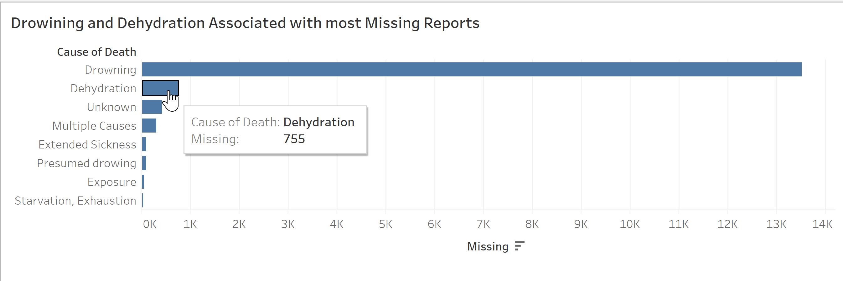
Drowning, followed by Dehydration, cause people to go missing

Slide 15

Demographics

Slide 16
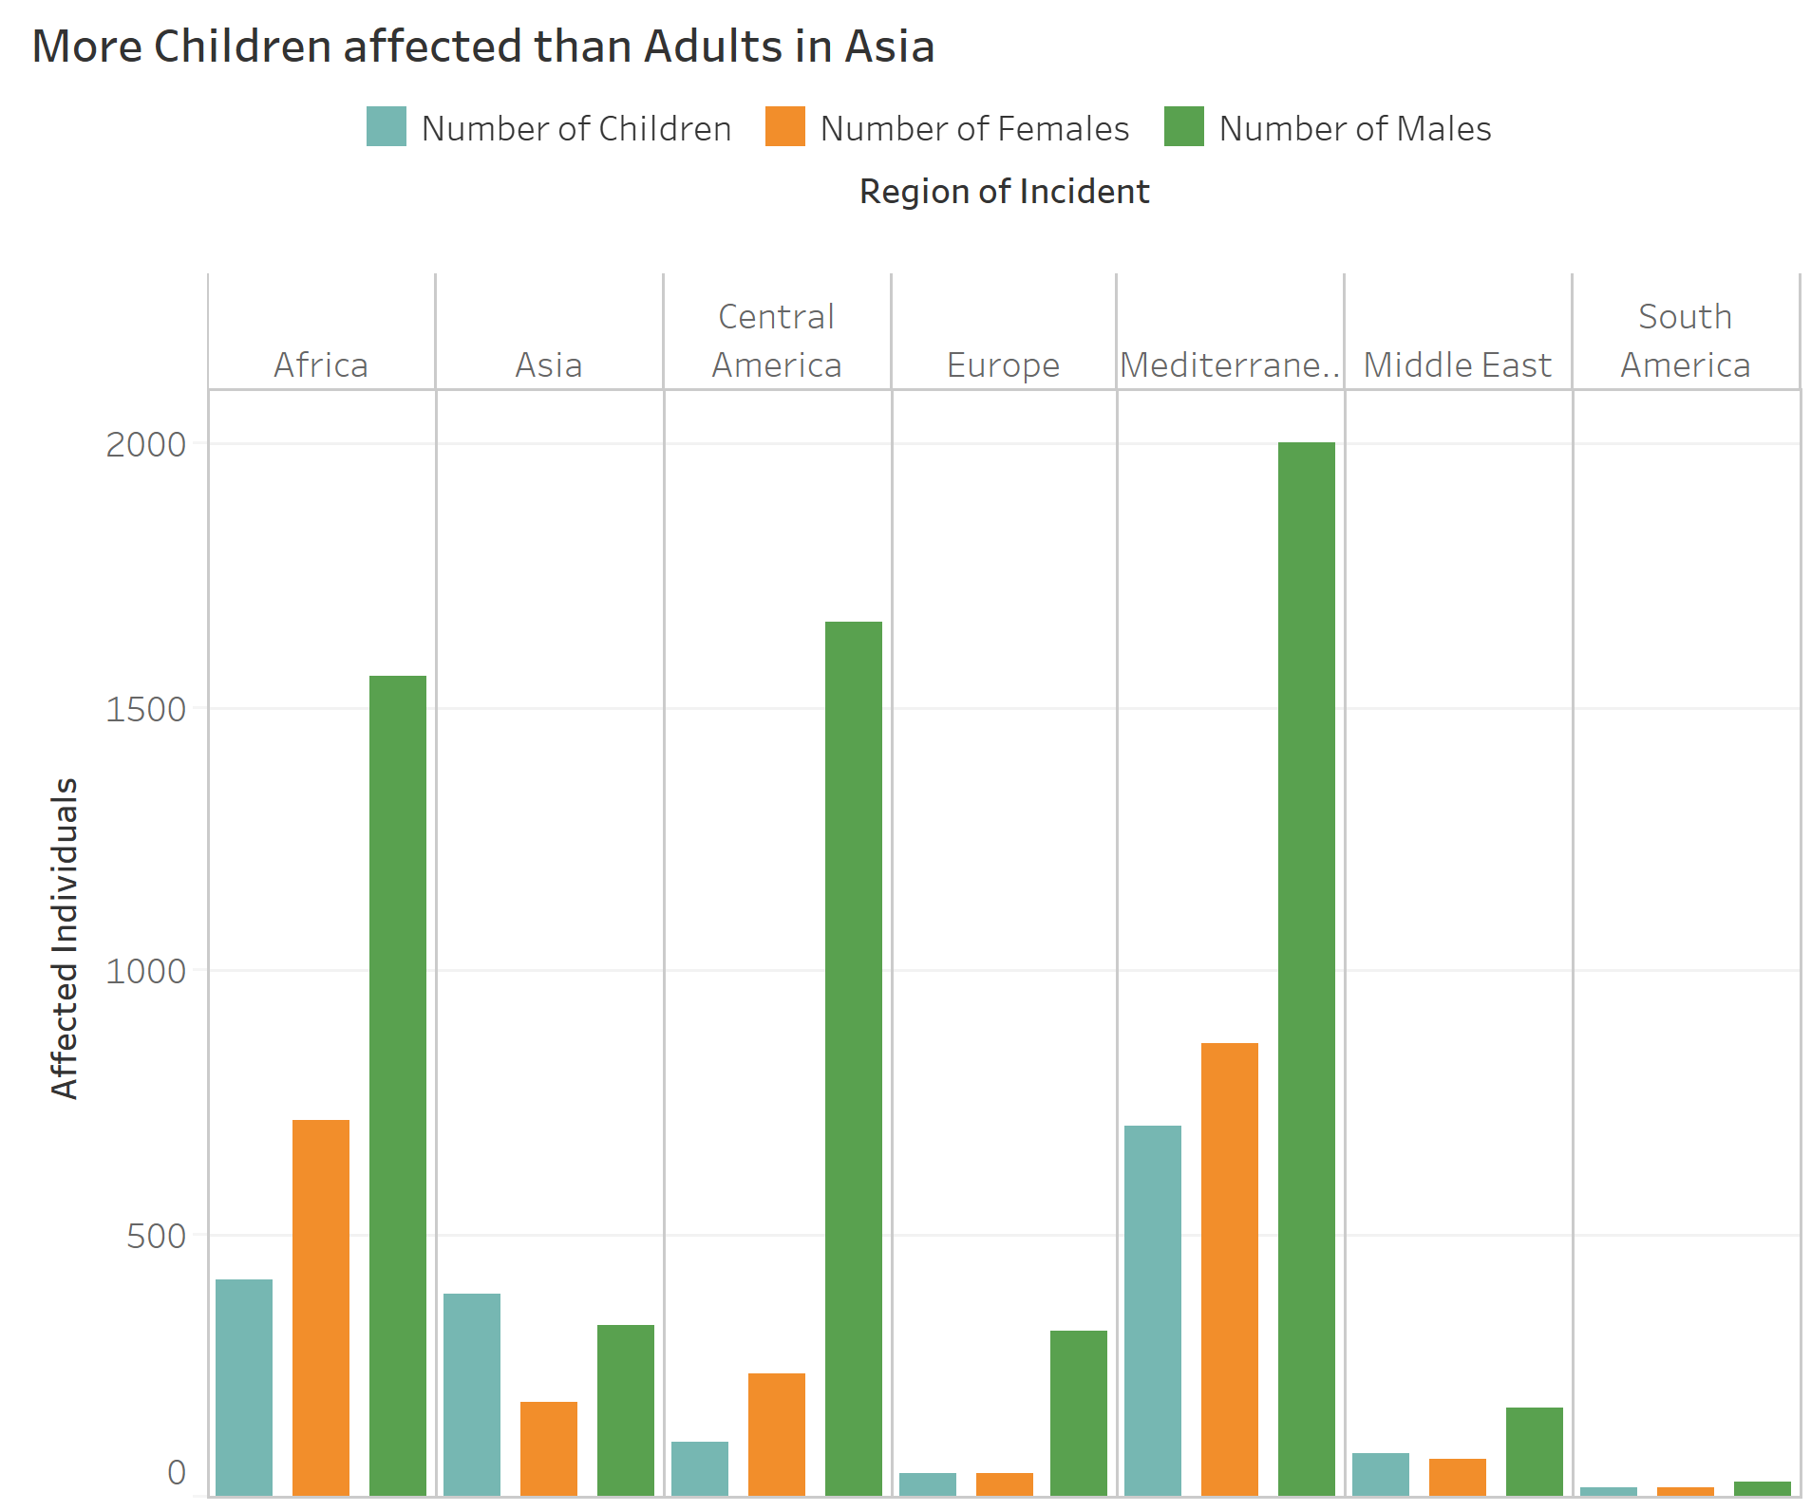
Most regions, trends are as expected
Asia has more children being affected than adults

Slide 17
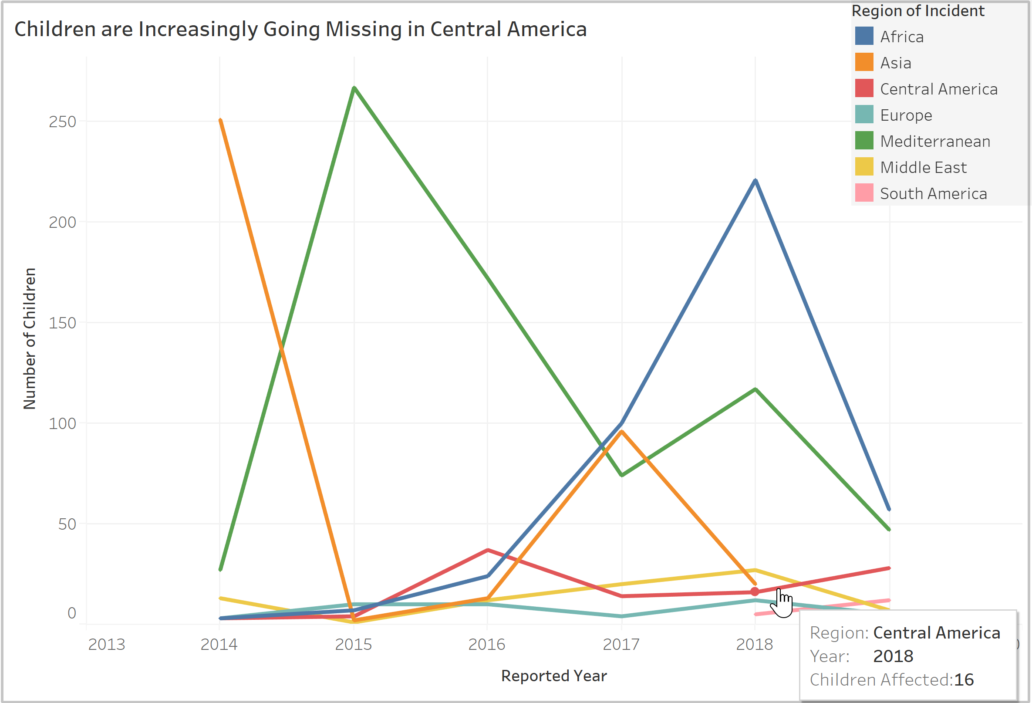
Similarly, in Central America:
Provides agencies with the power to investigate further and pre-empt forthcoming crisis

Slide 18
Migration Timeline and Patterns

Slide 19
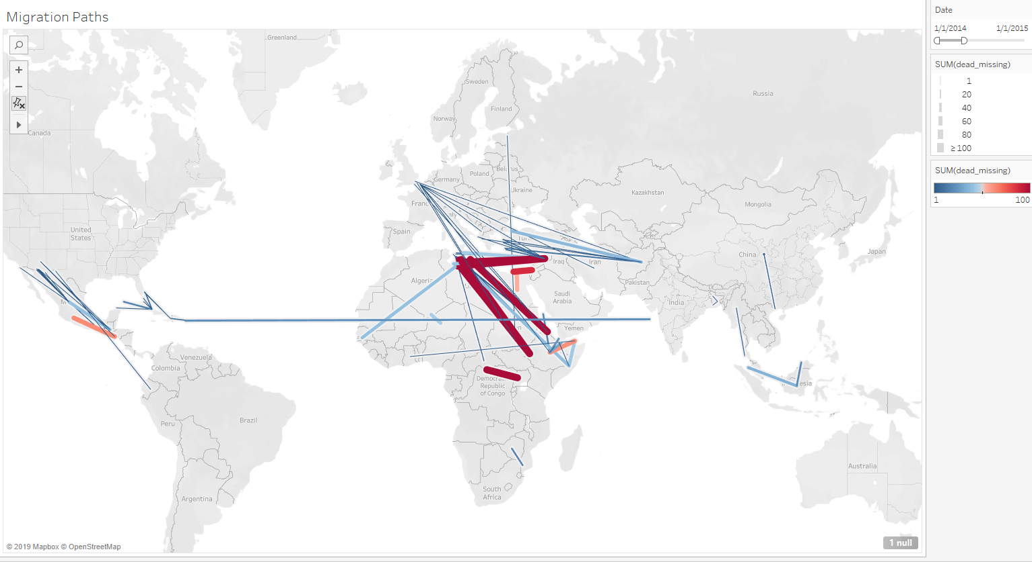
2014-2015
American Immigration Crisis
European Immigration Crisis
Eritrea Human Rights Persecution
Congo Ebola Outbreak

Slide 20
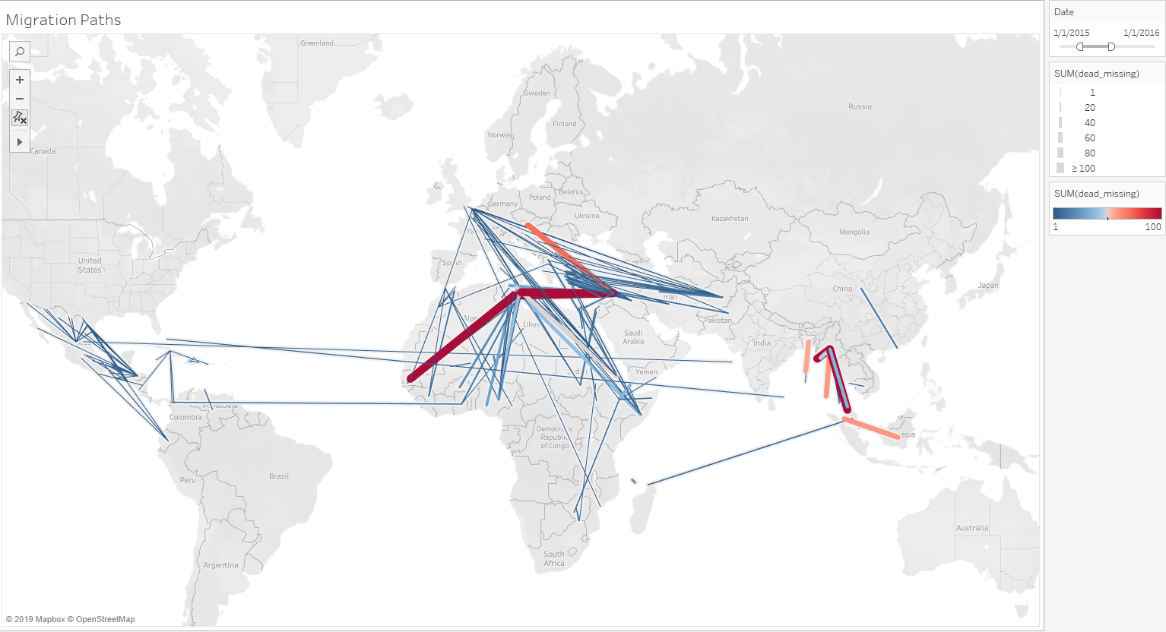
2015-2016
Niger Economic Crisis
Rohingya refugee crisis
Guinea Ebola Epidemic
Iraq Civil War

Slide 21
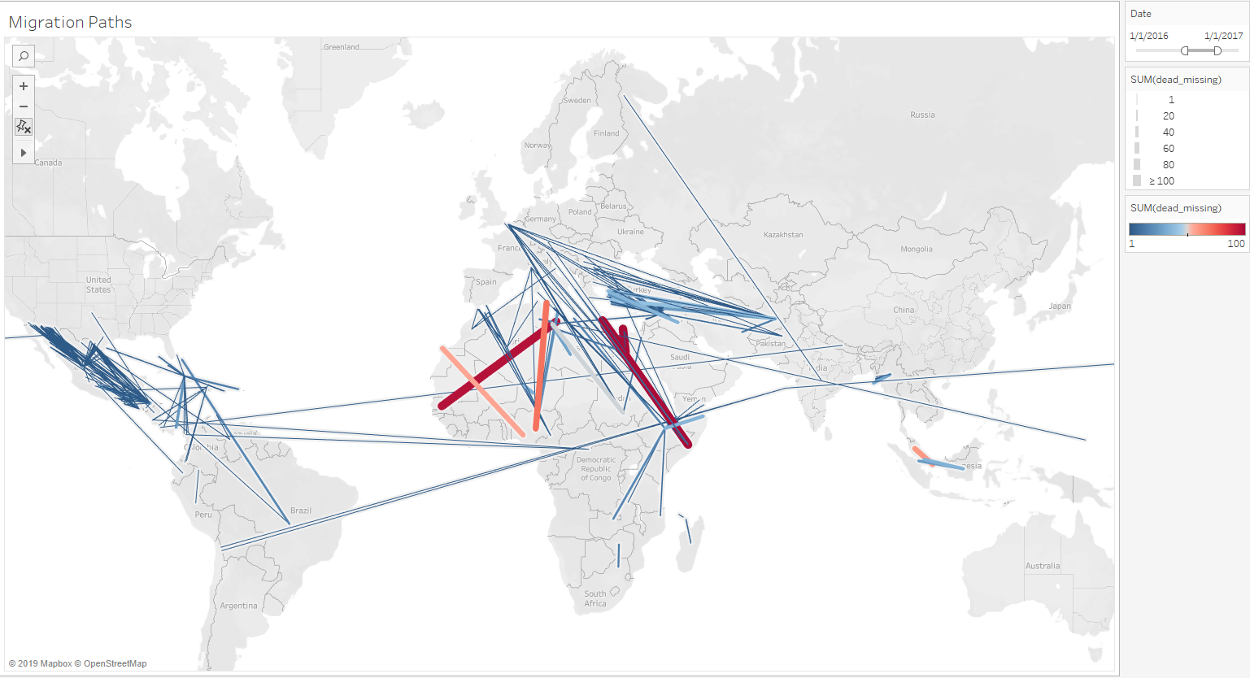
2016-2017
Guatemala corruption & poverty
Intensified Somalia War

Slide 22
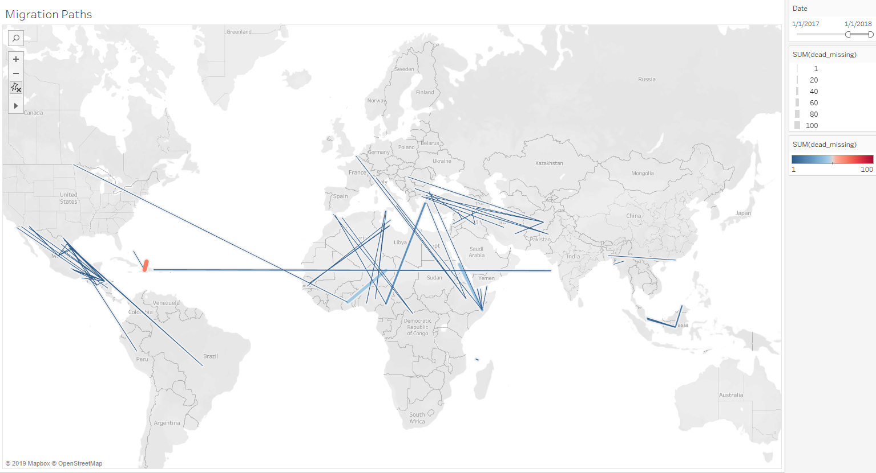
2017-2018
Reduction of Missing/Dead Migrants around the world
Despite IOM report increased percentage of migrants dying

Slide 23
International Policy Change
“Traditionally, migrants could take one of three sea passages to Europe—the western, central, or eastern Mediterranean route. The vast majority of 2015’s migrants took the eastern route, but a 2016 deal, which saw Turkey get billions in aid as well as political concessions from the EU in return for taking back migrants who landed in Greece, mostly closed off that path”
Overall deaths declined in 2018 because, in addition to the number of migrant journeys decreasing, the numbers taking the more dangerous central Mediterranean route have plunged. Most migrants arrived last year via the western Mediterranean instead, with some 64,000 landing in Spain. Italy, by comparison, received 23,000, down five-fold from 119,000 in 2017

Slide 24
How Can This Analysis Help

Slide 25
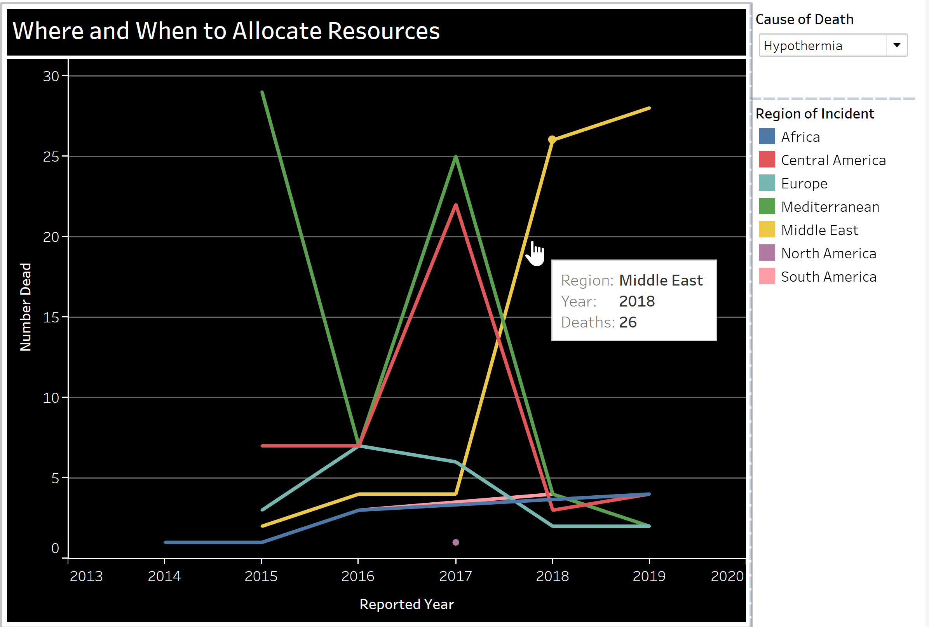
Resource Allocation

Slide 26
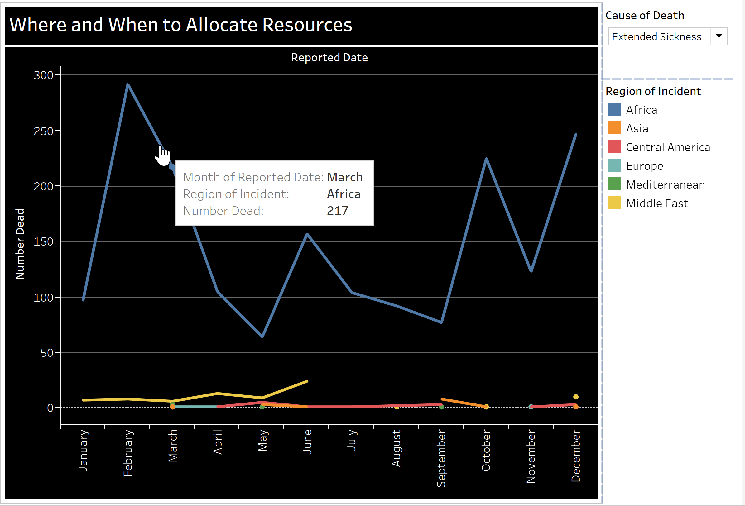

Slide 27
Practical Implications
International Organization for Migration
Nepal Earthquake
Refugee Analysis
Demographic based resource allocation

Slide 28
Conclusion
Migrants are dying less
But the causes for that decline call for further investigations
Analysis such as these can:
Help Aid Agencies identify patterns in problems arising around the world
Help Governments anticipate future needs
Help international Organizations understand where and when to intervene

Slide 29
Question?

